Slide 1
Heaps

Slide 2
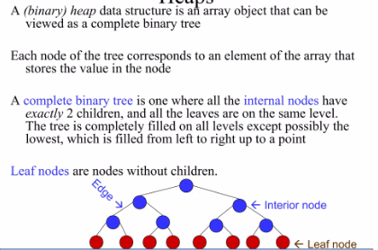
Heaps

Slide 3
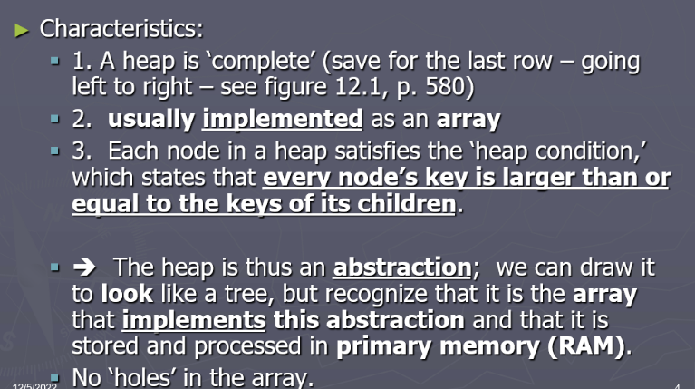

Slide 4
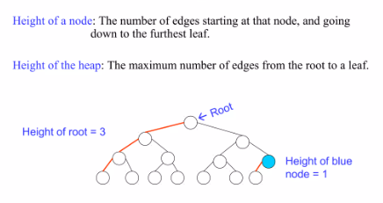
Heaps

Slide 5
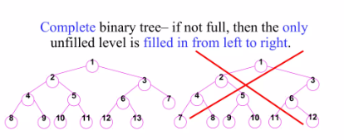
Heaps

Slide 6
Heap Tree Properties
Must follow two properties
Structural properties
Ordering properties
Structural Property
Tree must be ACBT (Almost complete binary tree)
We can move to next level when previous level is complete
Always fill the left child then right child

Slide 7
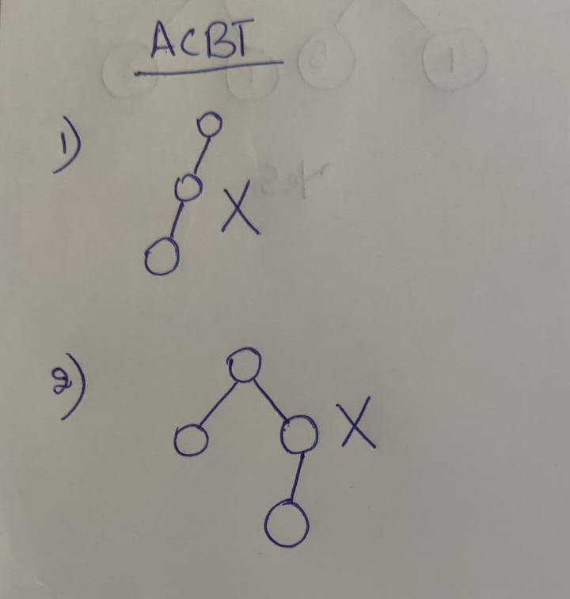

Slide 8
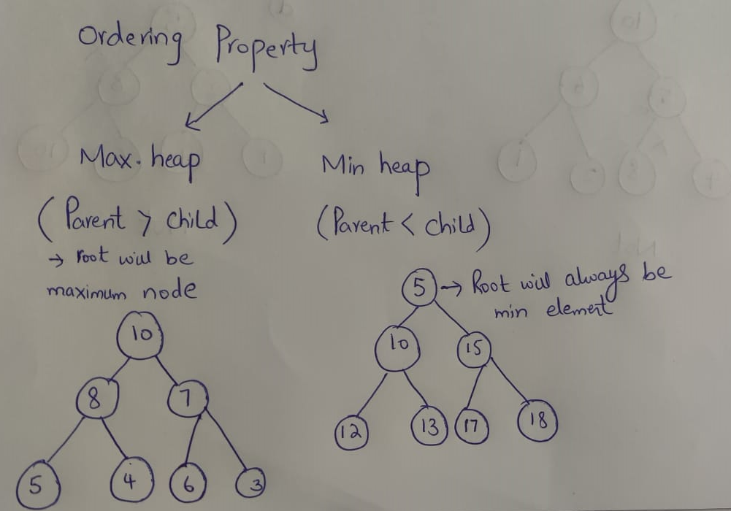
Heaps Properties
Ordering Property
Max heap
Min heap

Slide 9
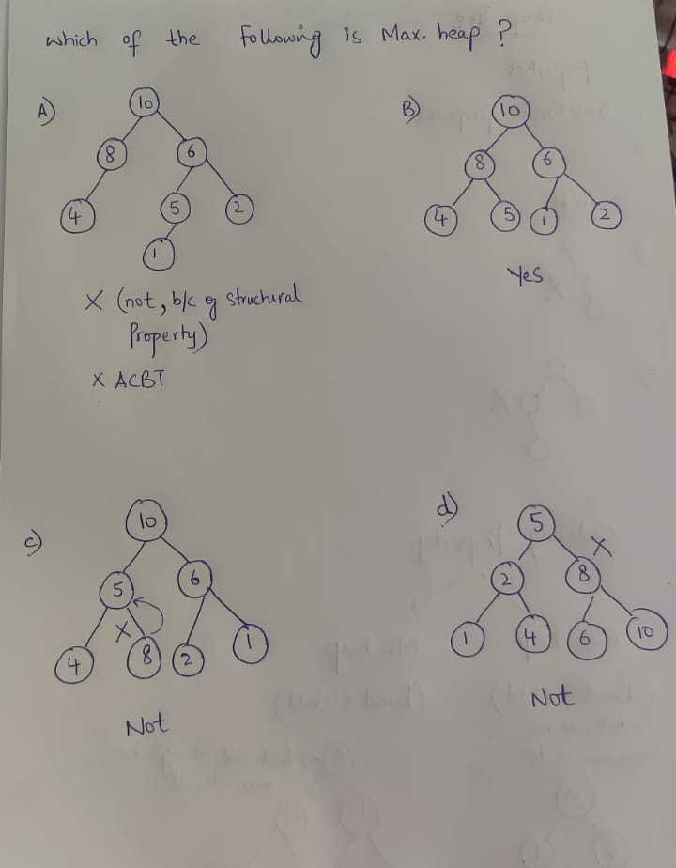

Slide 10
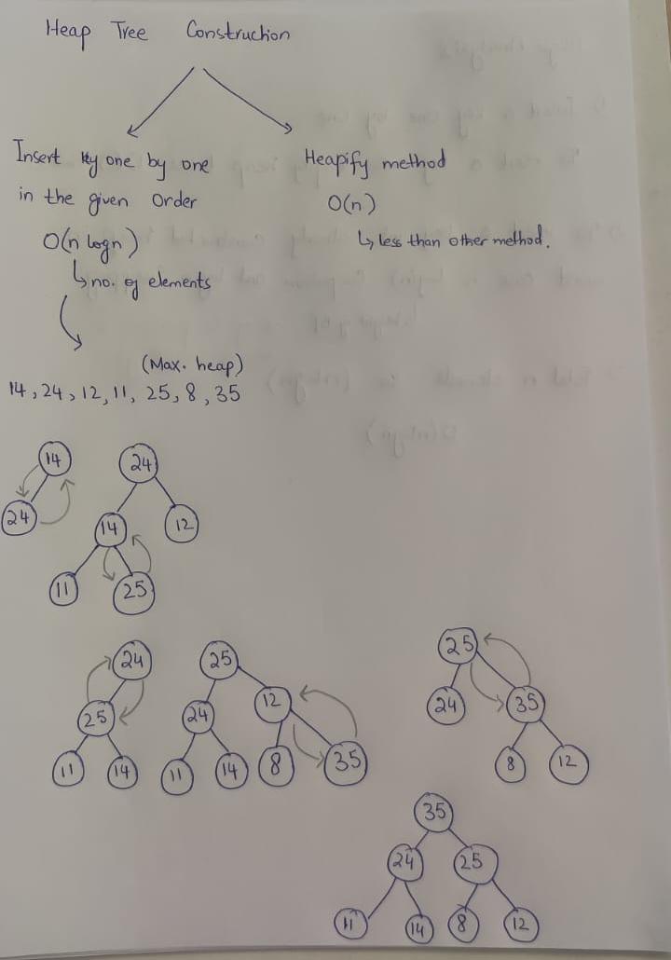
Insertion in Heap Tree

Slide 11
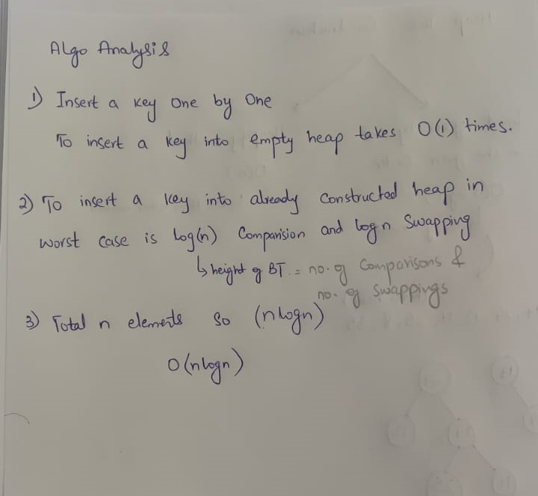
Analysis of Heaps

Slide 12
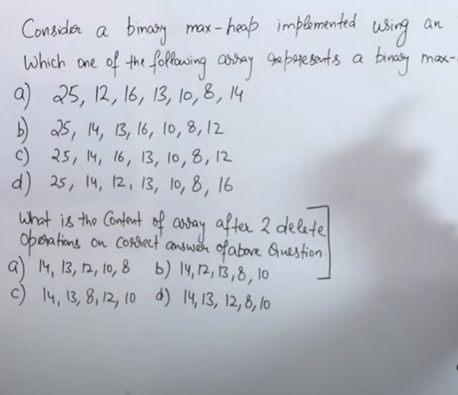

Slide 13
Adding a Node to a Heap
45
Put the new node in the next available spot.
Push the new node upward, swapping with its parent until the new node reaches an acceptable location.
35
23
27
21
22
4
19
42
Notes:
We can add new elements to a heap whenever we like. Because the heap is a complete binary search tree, we must add the new element at the next available location, filling in the levels from left-to-right.
In this example, I have just added the new element with a key of 42.
Of course, we now have a problem: The heap property is no longer valid. The 42 is bigger than its parent 27.
To fix the problem, we will push the new node upwards until it reaches an acceptable location.

Slide 14
Adding a Node to a Heap
45
Put the new node in the next available spot.
Push the new node upward, swapping with its parent until the new node reaches an acceptable location.
35
23
42
21
22
4
19
27
Notes:
Here we have pushed the 42 upward one level, swapping it with its smaller parent 27.
We can't stop here though, because the parent 35 is still smaller than the new node 42.

Slide 15
Adding a Node to a Heap
45
Put the new node in the next available spot.
Push the new node upward, swapping with its parent until the new node reaches an acceptable location.
42
23
35
21
22
4
19
27
Notes:
Can we stop now? Yes, because the 42 is less than or equal to its parent.

Slide 16
Adding a Node to a Heap
45
The parent has a key that is >= new node, or
The node reaches the root.
The process of pushing the new node upward is called reheapification upward.
42
23
35
21
22
4
19
27
Notes:
In general, there are two conditions that can stop the pushing upward:
1. We reach a spot where the parent is >= the new node, or
2. We reach the root.
This process is called reheapification upward (I didn't just make up that name, really).

Slide 17
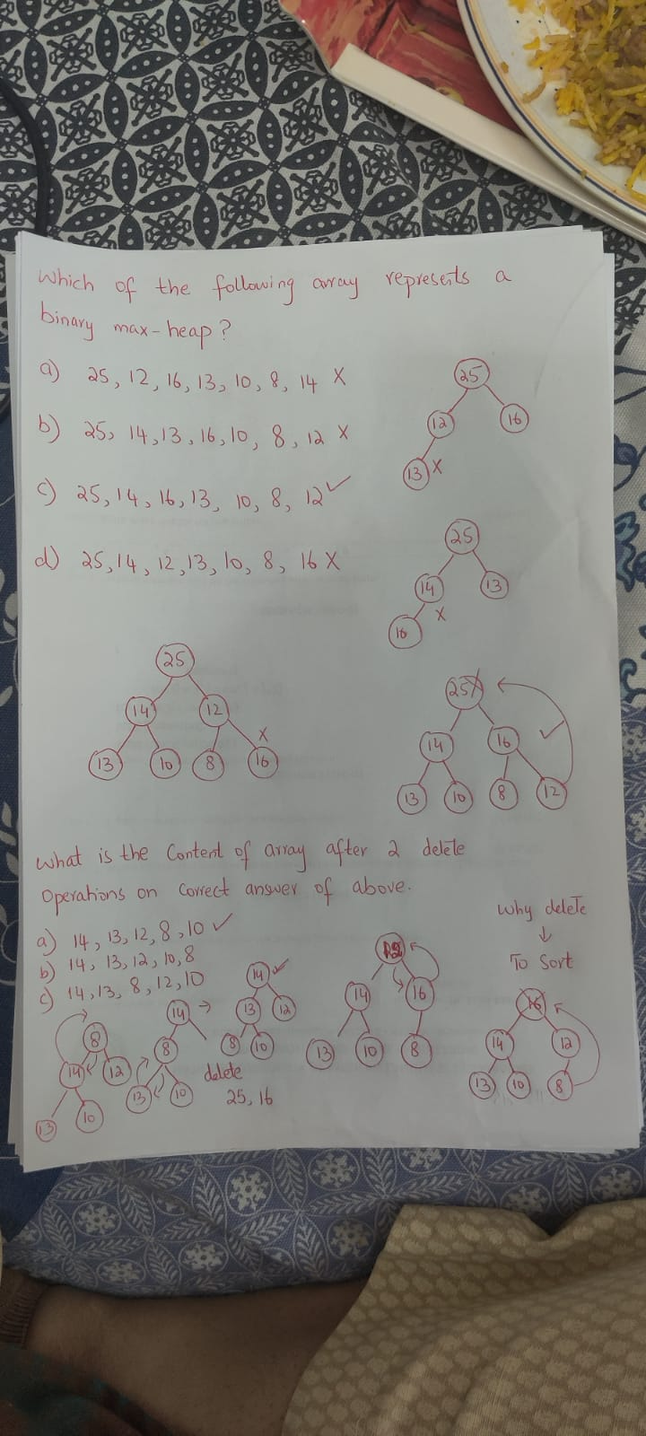

Slide 18
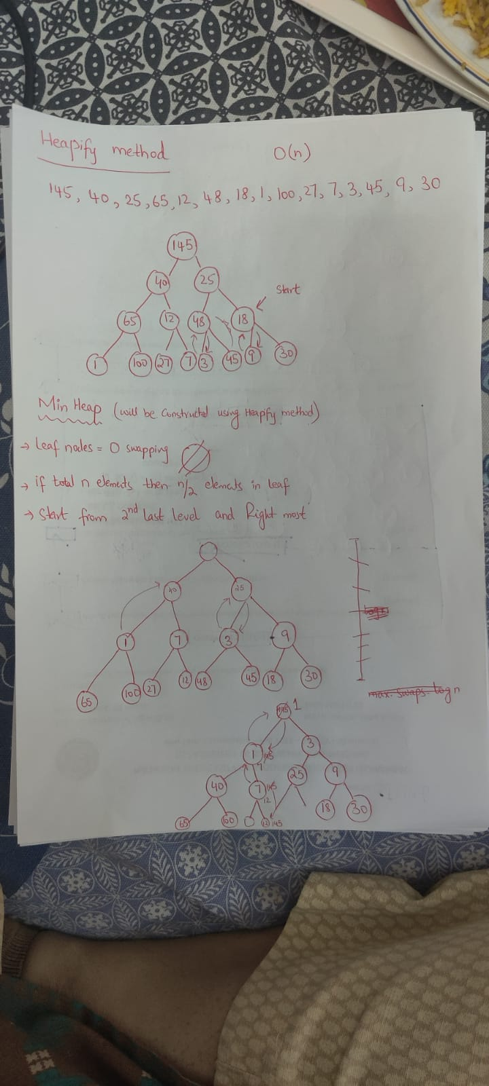
Heapify Method

Slide 19
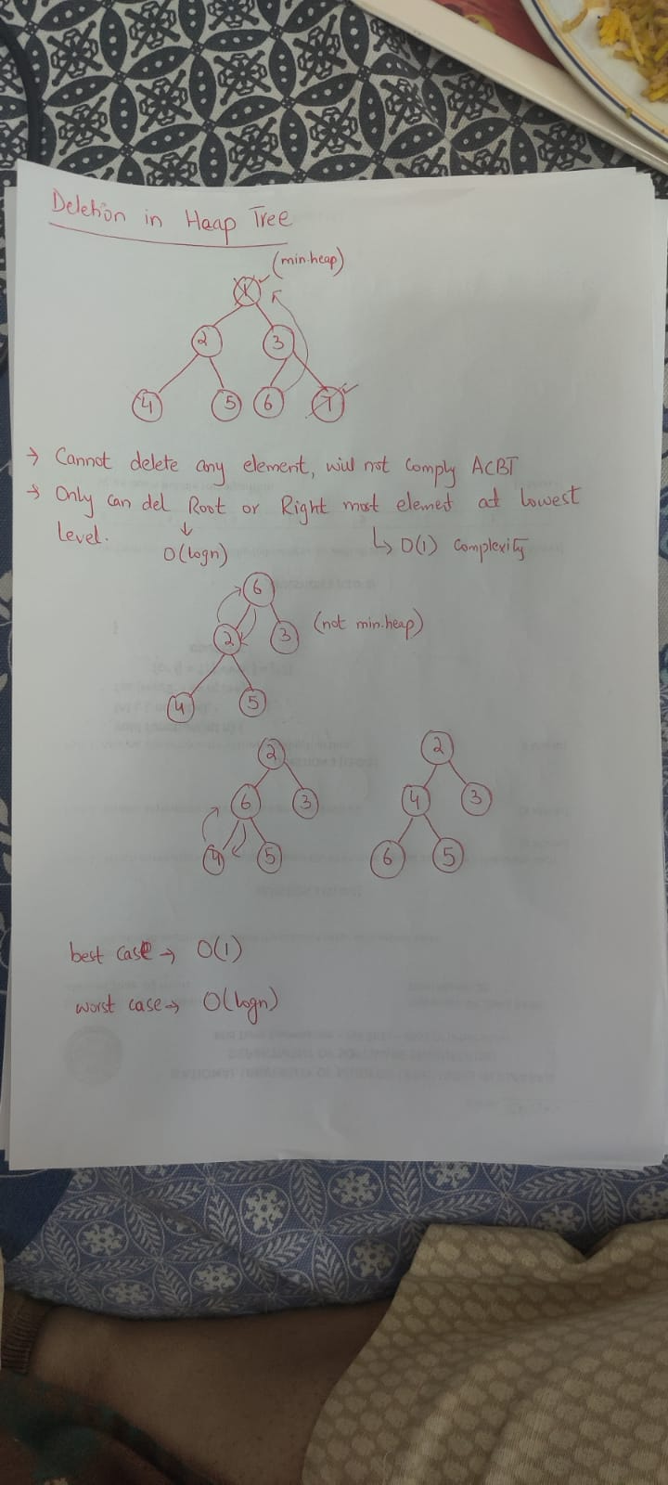
Deletion from the Heap

Slide 20
Removing the Top of a Heap
45
Move the last node onto the root.
42
23
35
21
22
4
19
27
Notes:
We can also remove the top node from a heap. The first step of the removal is to move the last node of the tree onto the root. In this example we move the 27 onto the root.

Slide 21
Removing the Top of a Heap
27
Move the last node onto the root.
42
23
35
21
22
4
19
Notes:
Now the 27 is on top of the heap, and the original root (45) is no longer around. But the heap property is once again violated.

Slide 22
Removing the Top of a Heap
27
Move the last node onto the root.
Push the out-of-place node downward, swapping with its larger child until the new node reaches an acceptable location.
42
23
35
21
22
4
19
Notes:
We'll fix the problem by pushing the out-of-place node downward. Perhaps you can guess what the downward pushing is called....reheapification downward.

Slide 23
Removing the Top of a Heap
42
Move the last node onto the root.
Push the out-of-place node downward, swapping with its larger child until the new node reaches an acceptable location.
27
23
35
21
22
4
19
Notes:
When we push a node downward it is important to swap it with its largest child. (Otherwise we are creating extra problems by placing the smaller child on top of the larger child.) This is what the tree looks like after one swap.
Should I continue with the reheapification downward?

Slide 24
Removing the Top of a Heap
42
Move the last node onto the root.
Push the out-of-place node downward, swapping with its larger child until the new node reaches an acceptable location.
35
23
27
21
22
4
19
Notes:
Yes, I swap again, and now the 27 is in an acceptable location.

Slide 25
Removing the Top of a Heap
42
The children all have keys <= the out-of-place node, or
The node reaches the leaf.
The process of pushing the new node downward is called reheapification downward.
35
23
27
21
22
4
19
Notes:
Reheapification downward can stop under two circumstances:
1. The children all have keys that are <= the out-of-place node.
2. The out-of-place node reaches a leaf.

Slide 26
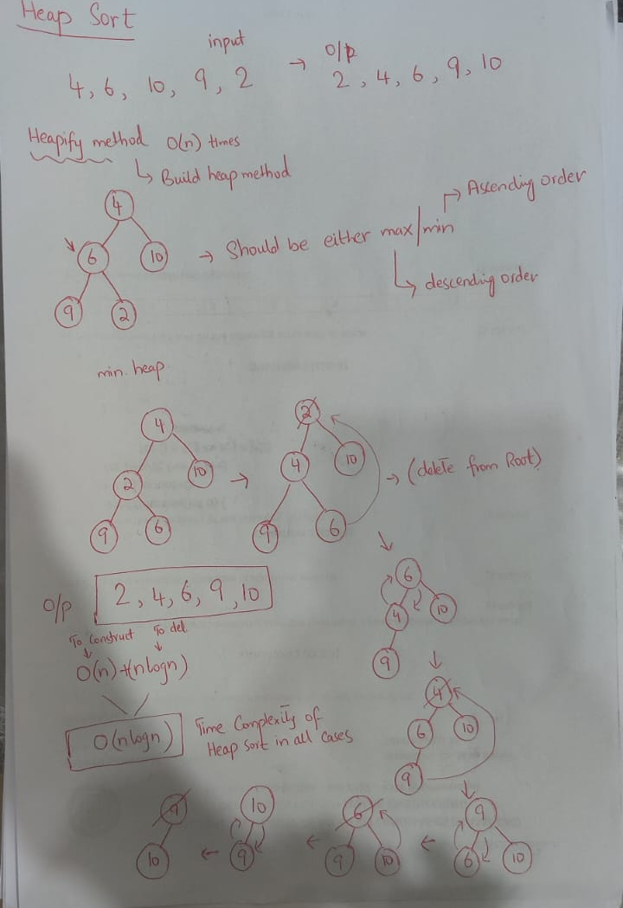
Heap Sort

Slide 27
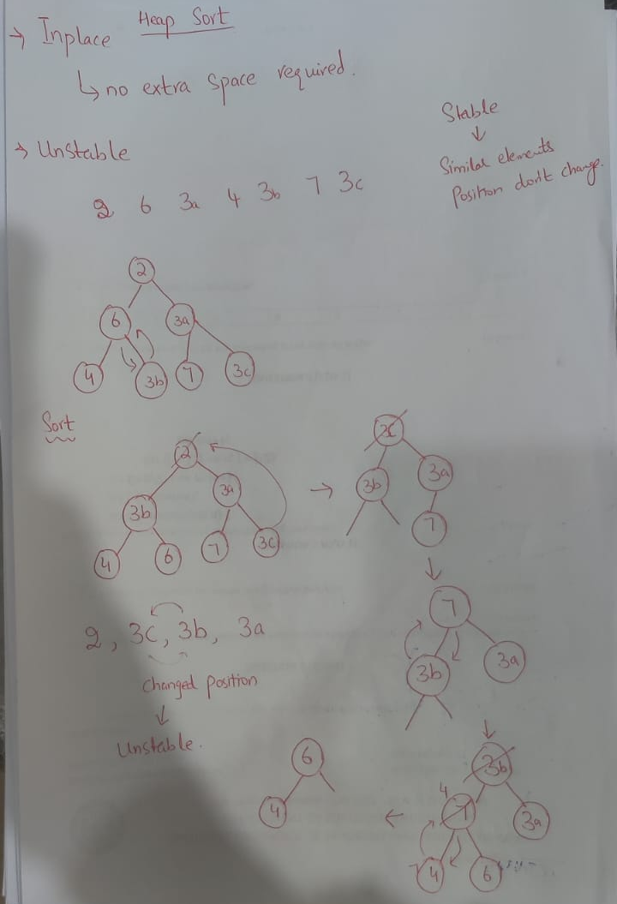

Slide 28
Graph Theory

Slide 29
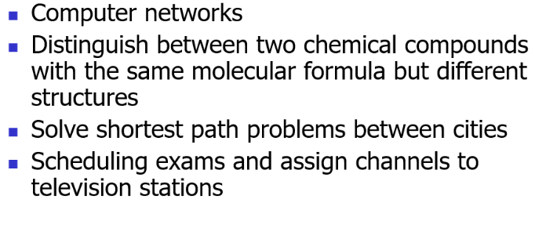
Graph Applications

Slide 30
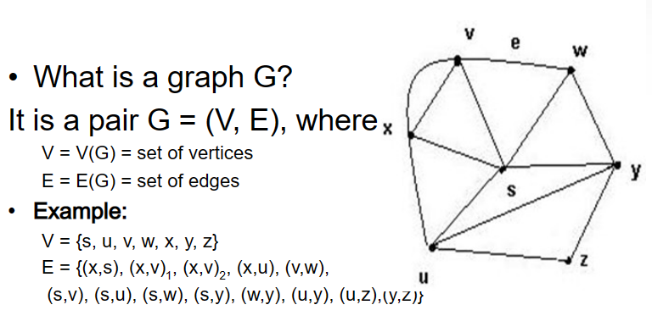
Introduction

Slide 31
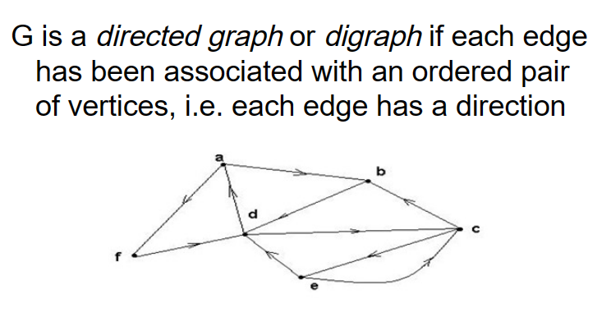
Directed Graph

Slide 32
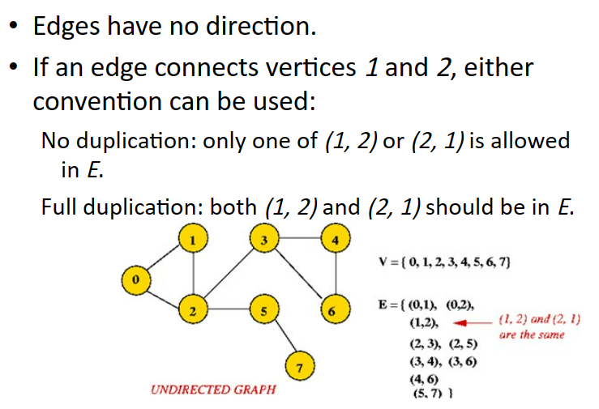
Undirected Graph

Slide 33
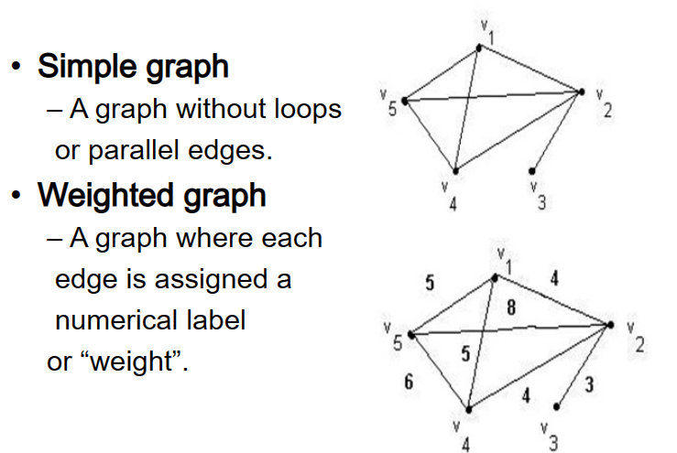
Special Graphs

Slide 34
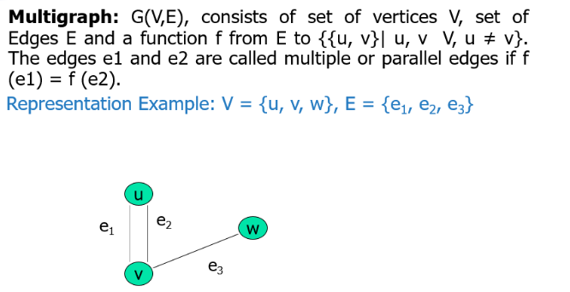
Multigraph

Slide 35
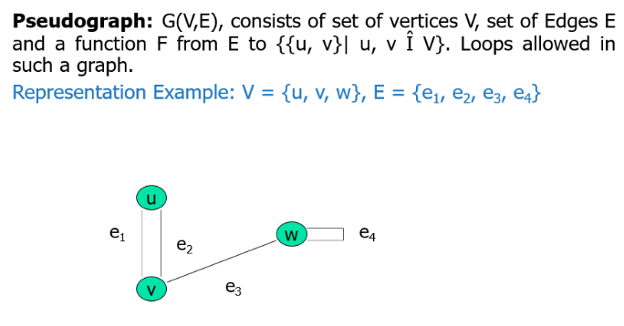
Pseudograph

Slide 36
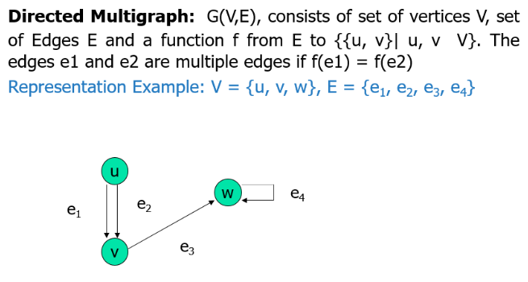
Directed Multigraph

Slide 37
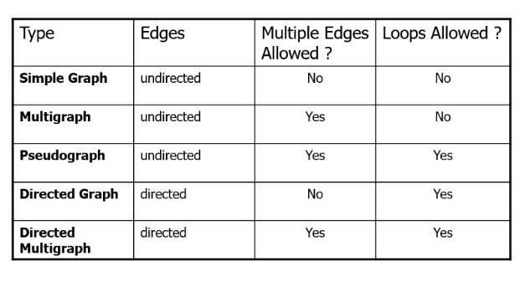
Summary- Graph Types

Slide 38
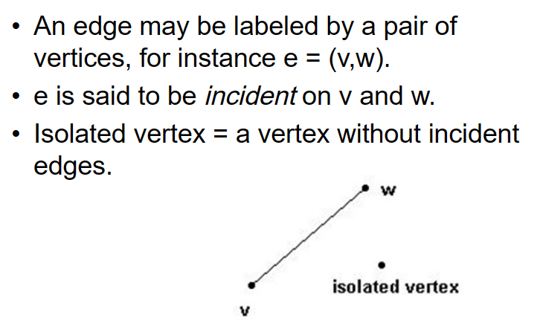
Edges

Slide 39
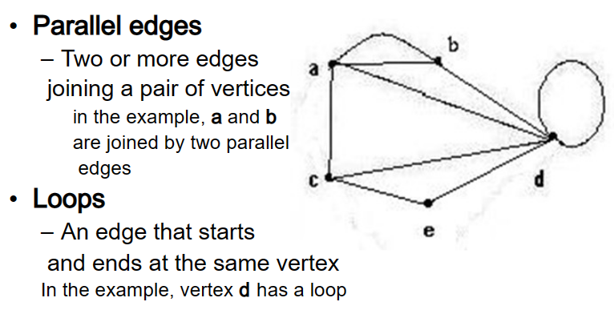
Special Edges

Slide 40
